Slide 1
CER3C3 Data Structures
Lecture 7

Slide 2
Linked Lists
Suppose the following list of all of the three letter English words ending in AT:
(BAT, CAT, EAT, FAT, HAT, JAT, LAT, MAT, OAT, PAT, RAT, SAT, TAT, VAT, WAT)
To make this list complete we naturally want to add the word GAT.
If we are using an array to keep this list, then the insertion of GAT will require us to move elements already in the list either one location higher or lower. We must either move HAT, JAT, LAT, ..., WAT or else move BAT, CAT, EAT and FAT.
If we have to do many such insertions into the middle, then neither alternative is attractive because of the amount of data movement.
On the other hand, suppose we decide to remove the word LAT. Then again, we have to move many elements so as to maintain the sequential representation of the list.

Slide 3
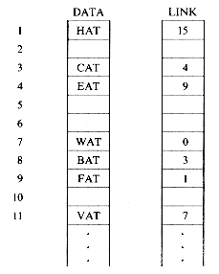
Linked Lists
An elegant solution to this problem of data movement in sequential representations is achieved by using linked representations. Unlike a sequential representation where successive items of a list are located a fixed distance apart, in a linked representation these items may be placed anywhere in memory.

Slide 4

Linked List Representation
It is customary to draw linked lists as an ordered sequence of nodes with links being represented by arrows as in figure. This is so that we reinforce in our own mind the facts that
(i) the nodes do not actually reside in sequential locations, and that
(ii) the locations of nodes may change on different runs. Therefore, when we write a program which works with lists, we almost never look for a specific address except when we test for zero.

Slide 5
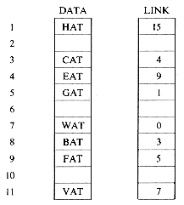
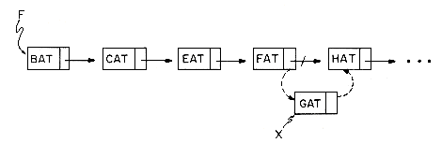
How insertions will be done?
Figure a shows how the arrays DATA and LINK will be changed after we insert GAT. Figure b shows how we can draw the insertion using our arrow notation. The new arrows are dashed. The important thing to notice is that when we insert GAT we do not have to move any other elements which are already in the list. We have overcome the need to move data at the expense of the storage needed for the second field, LINK. But we will see that this is not too severe a penalty.

Slide 6

How Deletions will be performed?
Now suppose we want to delete GAT from the list. All we need to do is find the element which immediately precedes GAT, which is FAT, and set LINK(9) to the position of HAT which is 1. Again, there is no need to move the data around. Even though the LINK field of GAT still contains a pointer to HAT, GAT is no longer in the list.

Slide 7
Functions required for creating a linked list
Linked lists we see that the following capabilities are needed to make linked representations possible:
(i) A means for dividing memory into nodes each having at least one link field;
(ii) A mechanism to determine which nodes are in use and which are free;
(iii) A mechanism to transfer nodes from the reserved pool to the free pool and vice-versa.
Though DATA and LINK look like conventional one dimensional arrays, it is not necessary to implement linked lists using them. For the time being let us assume that all free nodes are kept in a "black box" called the storage pool and that there exist subalgorithms:
(i) GETNODE(X) which provides in X a pointer to a free node but if no node is free, it prints an error message and stops;
(ii) RET(X) which returns node X to the storage pool.

Slide 8

Create a Node in Linked List
Example 1 : Assume that each node has two fields DATA and LINK. The following algorithm creates a linked list with two nodes whose DATA fields are set to be the values 'MAT' and 'PAT' respectively. T is a pointer to the first node in this list.
procedure CREATE(T)
call GETNODE(I) //get an available node//
T ← I; DATA(I) ← 'MAT' //store information into the node//
call GETNODE(I) //get a second available node//
LINK(T) ← I // attach first node to the second//
LINK(I) ← 0: DATA(I) ← 'PAT'
end CREATE

Slide 9
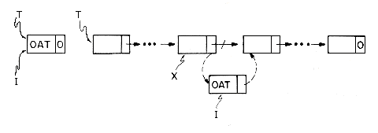
Insert a Node in the linked list
Example 2 : Let T be a pointer to a linked list. T= 0 if the list has no nodes. Let X be a pointer to some arbitrary node in the list T. The following algorithm inserts a node with DATA field 'OAT' following the node pointed at by X.
procedure INSERT(T,X)
call GETNODE(I)
DATA(I) ← 'OAT'
//insert into empty list//
if T = 0 then [T ← I; LINK(I)← 0]
//insert after X//
else [LINK(I) ← LINK(X)
LINK(X) ← I]
end INSERT

Slide 10
Delete a Node
Example 3: Let X be a pointer to some node in a linked list T as in example 2. Let Y be the node preceding X. Y = 0 if X is the first node in T (i.e., if X = T). The following algorithm deletes node X from T
procedure DELETE(X, Y, T)
if Y= 0 then T← LINK(T) //remove the first node//
else LINK(Y) ← LINK(X) //remove an interior node//
call RET(X) //return node to storage pool//
end DELETE

Slide 11
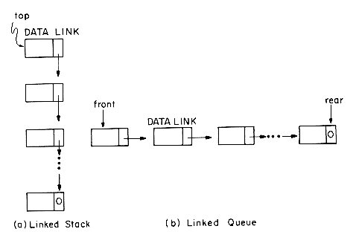
Stack and Queue Representation as Linked List

Slide 12
Stack Implementation using Linked List
procedure ADDS(i, Y)
//add element Y onto stack i//
call GETNODE(X)
DATA(X) ← Y //store data value Y into new node//
LINK(X) ← T(i) //attach new node to top of i-th stack//
T(i) ← X //reset stack pointer//
end ADDS
procedure DELETES(i, Y)
//delete top node from stack i and set Y to be the DATA field of this node//
if T(i) = 0 then call STACK__EMPTY
X ← T(i) //set X to top node of stack i//
Y ← DATA(X) //Y gets new data//
T(i) ← LINK(X) //remove node from top of stack i//
call RET(X) //return node to storage pool//
end DELETES

Slide 13
Queue Implementation using Linked List
procedure ADDQ(i,Y) //add Y to the ith queue//
call GETNODE(X)
DATA(X) ← Y: LINK(X) ← 0
if F(i) = 0 then [F(i) ← R(i) ← X] //the queue was empty//
else [LlNK(R(i)) ← X;R(i) ← X] //the queue was not empty//
end ADDQ
procedure DELETEQ(i, Y) //delete the first node in the ith queue, set Y to its DATA field//
if F(i) = 0 then call QUEUE__EMPTY
else [X ← F(i); F(i) ← LINK(X)
//set X to front node//
Y ← DATA(X); call RET(X)] //remove data and return node//
end DELETEQ

Slide 14


Application : Polynomial Addition
For instance, the polynomial A= 3x14 + 2x8 + 1 would be stored as
while B = 8x14 - 3x10 + 10x6 would look like
COEFF | EXP | LINK

Slide 15
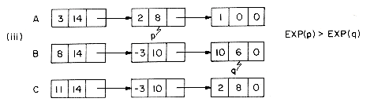
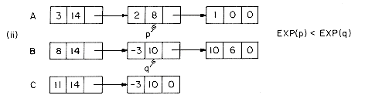
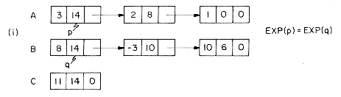
Polynomial Addition Logic

Slide 16
Attach Function
procedure ATTACH(C,E,d)
//create a new term with COEF = C and EXP = E and attach it to the node pointed at by d//
call GETNODE(I)
EXP(I) ← E
COEF(I) ← C
LINK(d) ← I //attach this node to the end of this list//
d ← I //move pointer d to the new last node//
end ATTACH

Slide 17
Polynomial Addition Algorithm
procedure PADD(A,B,C)
//polynomials A and B represented as singly linked lists are summed to form the new list named C//
1 p ← A; q ← B //p,q pointers to next term of A, B//
2 call GETNODE(C); d ← C //initial node for C, returned later//
3 while p ≠ 0 and q ≠ 0 do //while there are more terms in A and B//
4 case
5 : EXP(p) = EXP(q): //equal exponents//
6 x ← COEF(p) + COEF(q)
7 if x ≠ 0 then call ATTACH(x, EXP(p),d)
8 p ← LINK(p); q ← LINK(q) //advance to next terms//
9 : EXP(p) < EXP(q):
10 call ATTACH(COEF(q),EXP(q),d)
11 q ← LINK(q) //advance to next term//
12 : else: call ATTACH(COEF(p),EXP(p),d)

Slide 18
Polynomial Addition Algorithm
13 p ← LINK(p) //advance to next term of A//
14 end
15 end
16 while p ≠ 0 do //copy remaining terms of A//
17 call ATTACH(COEF(p),EXP(p),d)
18 p ← LINK(p)
19 end
20 while q ≠ 0 do //copy remaining terms of B//
21 call ATTACH(COEF(q),EXP(q),d)
22 q ← LINK(q)
23 end
24 LINK(d) ← 0; t ← C; C ← LINK(C) //delete extra initial node//
25 call RET(t)
26 end PADD

Slide 19
More Operations on LL : Invert
procedure INVERT(X)
//a chain pointed at by X is inverted so that if X = (a₁, ...,a_{m}) then after execution X = (a_{m}, ...,a₁)//
p ← X;q ← 0
while p ≠ 0 do
r ← q;q ← p //r follows q; q follows p//
p ← LINK(p) //p moves to next node//
LINK(q)← r //link q to previous node//
end
X ← q
end INVERT

Slide 20
More Operations on LL : Concatenate
procedure CONCATENATE(X, Y, Z)
//X = (a₁, ...,a_{m}), Y = (b₁, ...,b_{n}), m,n 0, produces a new chain Z = (a₁, ...,a_{m},b₁ , ...,b_{n})//
Z ← X
if X = 0 then [Z ← Y; return]
if Y = 0 then return
p ← X
while LINK(p) ≠ 0 do //find last node of X//
p ← LINK(p)
end
LINK(p) ← Y //link last node of X to Y//
end CONCATENATE

Slide 21

Circular Linked List
A list in which the last node points back to the first will be termed a circular list. A chain is a singly linked list in which the last node has a zero link field.
Any node can be starting point

Slide 22
Insert Operation : Circular Linked List
procedure INSERT__FRONT(A, X)
//insert the node pointed at by X to the front of the circular list A, where A points to the last node//
if A = 0 then [A ← X
LINK (X) ← A]
else [LINK(X) ← LINK (A)
LINK(A) ← X]
end INSERT__FRONT

Slide 23
Length function : CLL
procedure LENGTH(A)
//find the length of the circular list A//
i ← 0
if A ≠ 0 then [ptr ← A
repeat
i ← i + 1; ptr ← LINK(ptr)
until ptr = A ]
return (i)
end LENGTH

